Slide 1
Kilosort guide
Or Bashan

Slide 2

Practical guide for kilosort usage

Slide 3
Know your probe, and map the channels in the .cfg file.
Record the raw data with no high pass filter.
Convert the raw data (CSC#.ncs files) to a single .dat file.
Create a channel map.
Sine up to https://www.ontologic.ly/ and upload the .dat and channel map files.
Run kilosort 2.5 (make sure to change the relevant hipper parameters).
Run Phy on the kilosort results, go threw the results and merge/split/reassign the relevant clusters.
Download kilosort and phy results.
Read .npy files on matlab (using GitHub\npy-matlab library).
Analyze your data ☺

Slide 4
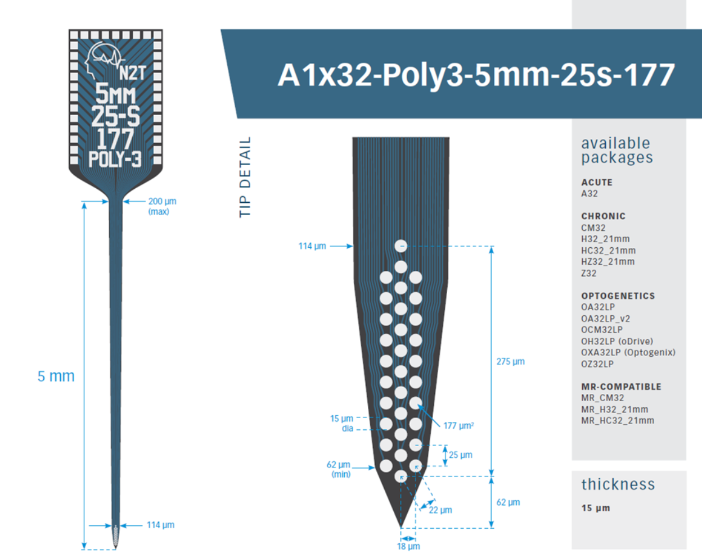
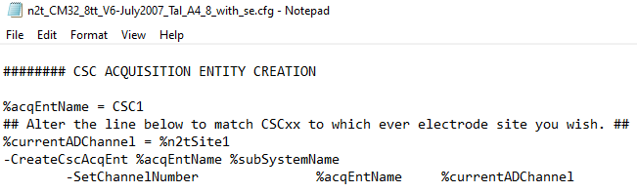
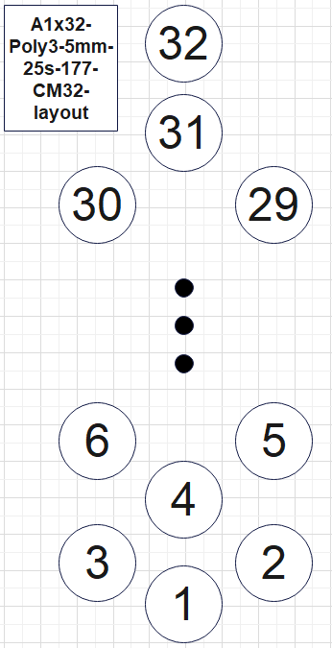
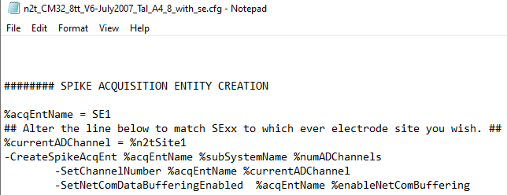
1. Know your probe, and map the channels in the .cfg file.

Slide 5
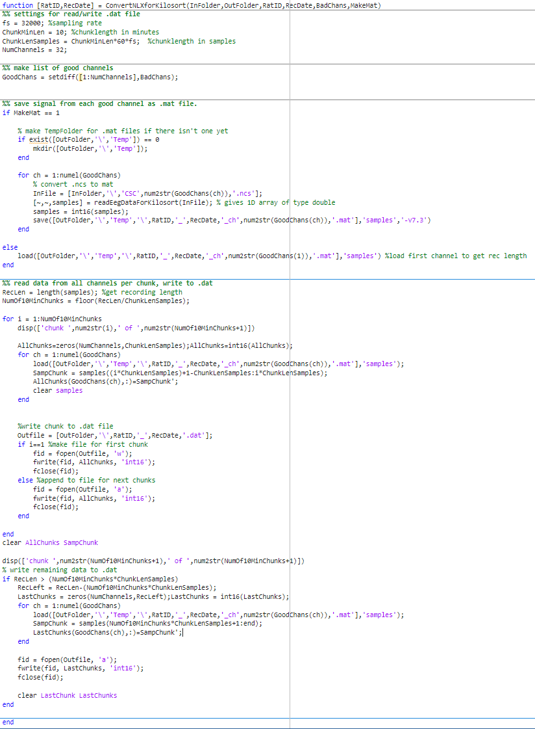
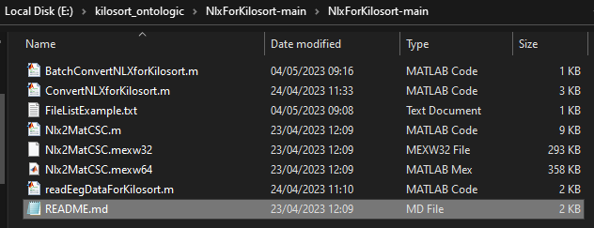
3. Convert the raw data (CSC#.ncs files) to a single .dat file.

Slide 6
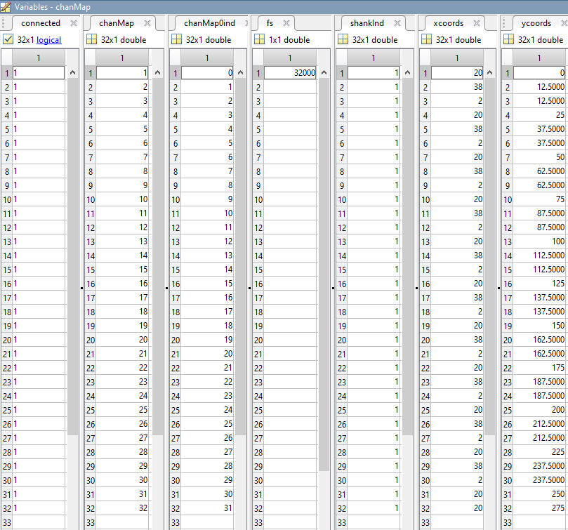
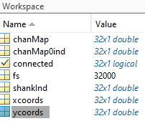
4. Create a channel map.

Slide 7
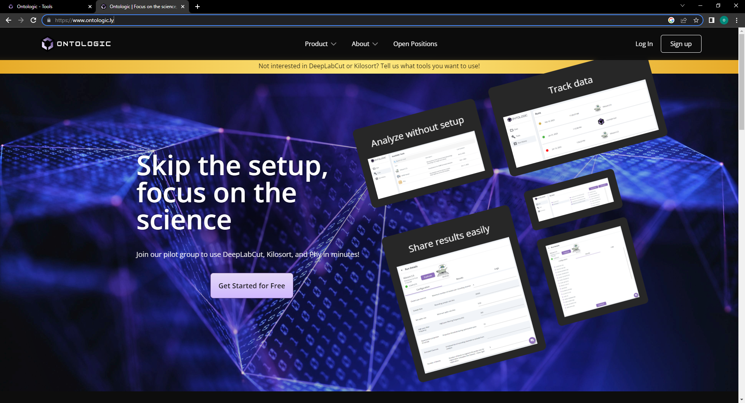
Sine up to https://www.ontologic.ly/ and upload the .dat and channel map files.

Slide 8
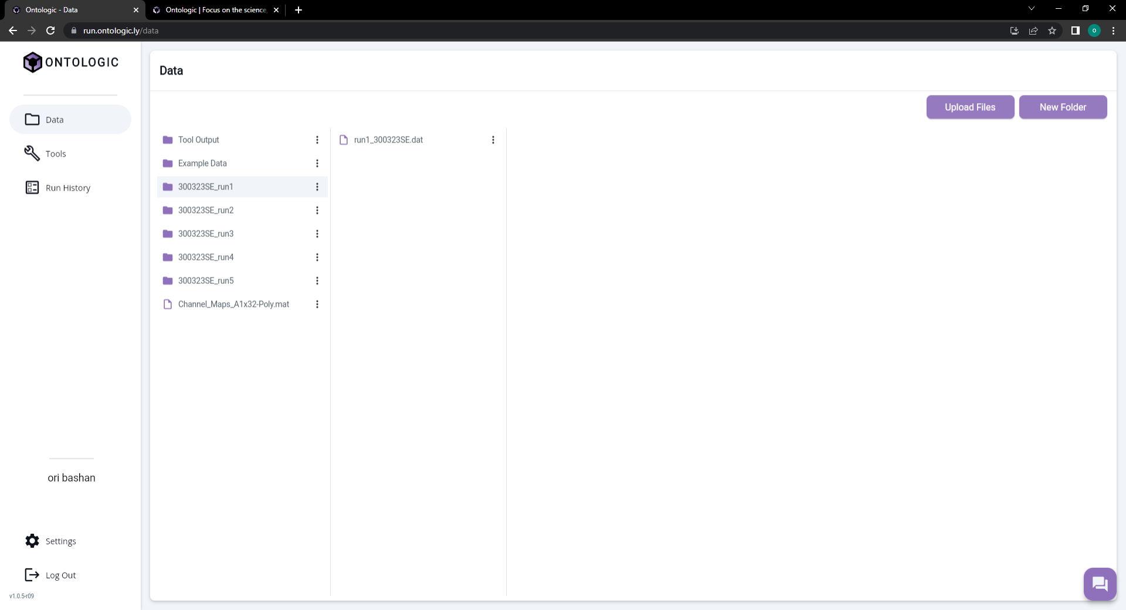

Slide 9
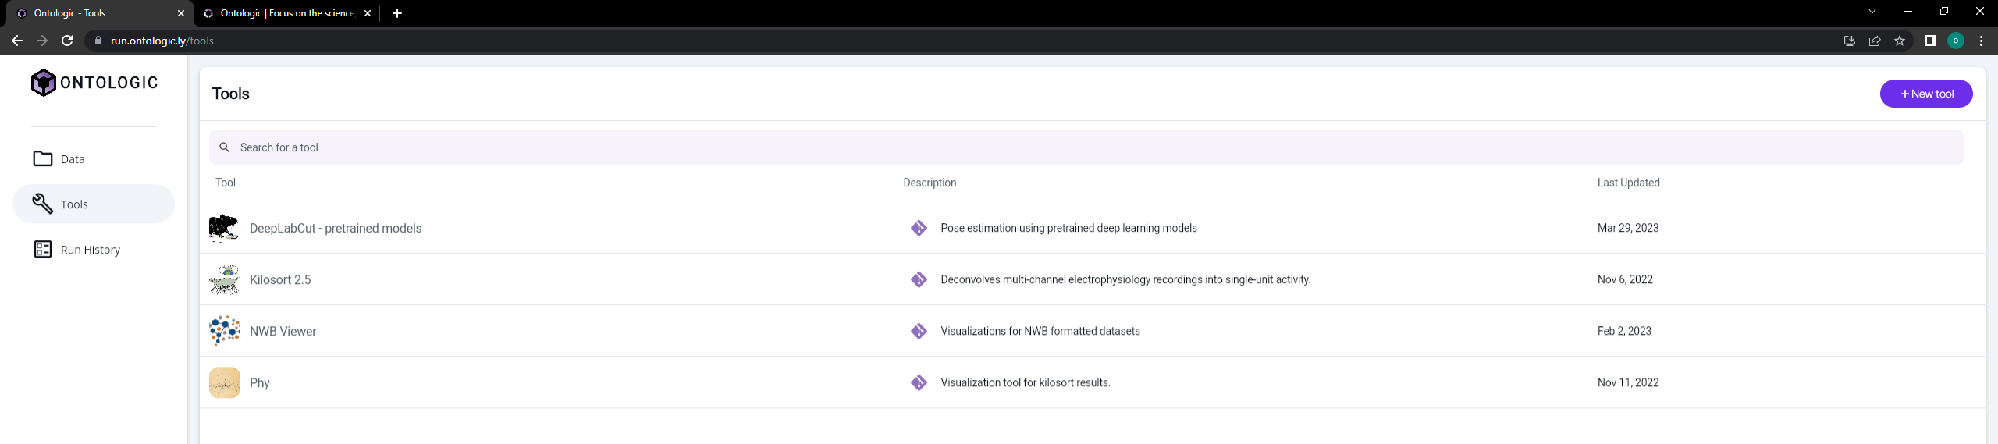
6. Run kilosort 2.5 (make sure to change the relevant hipper parameters).

Slide 10
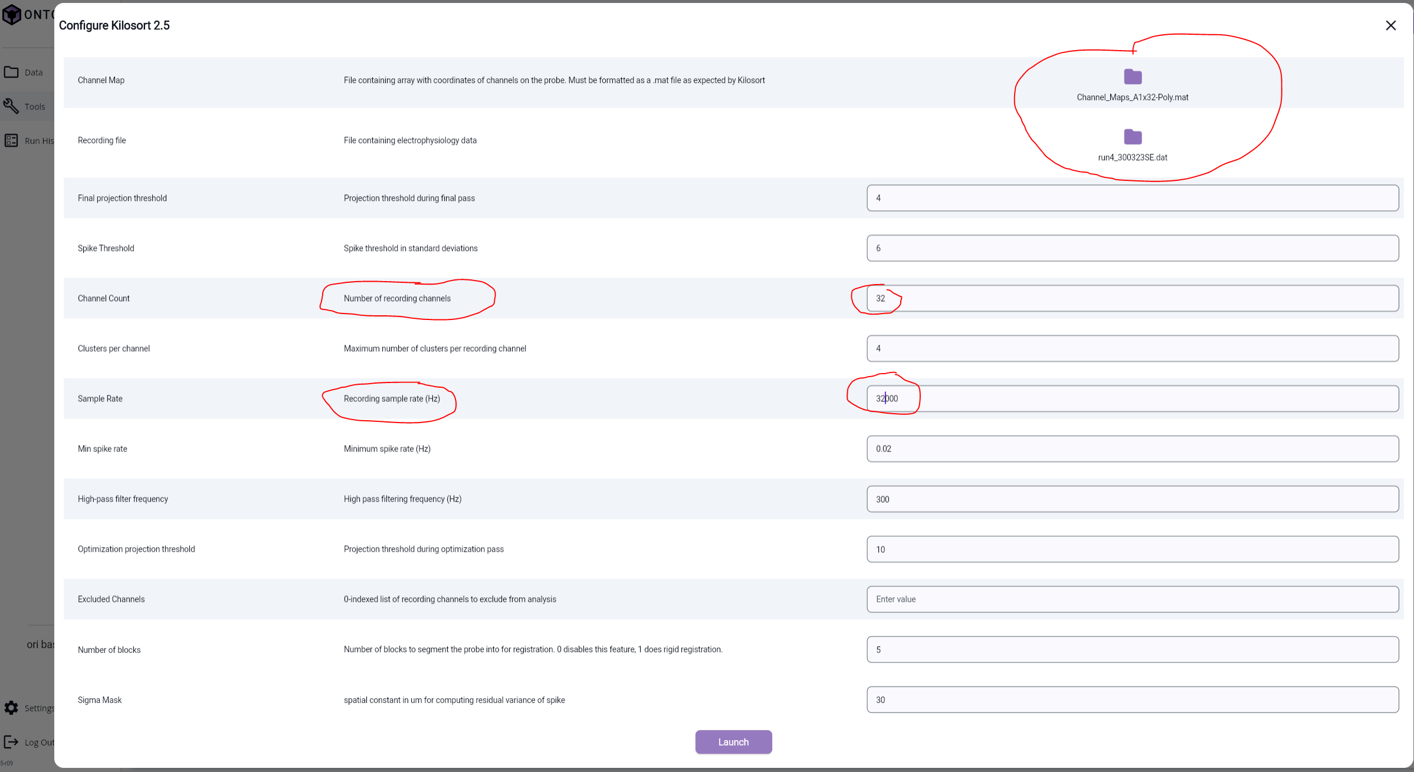

Slide 11
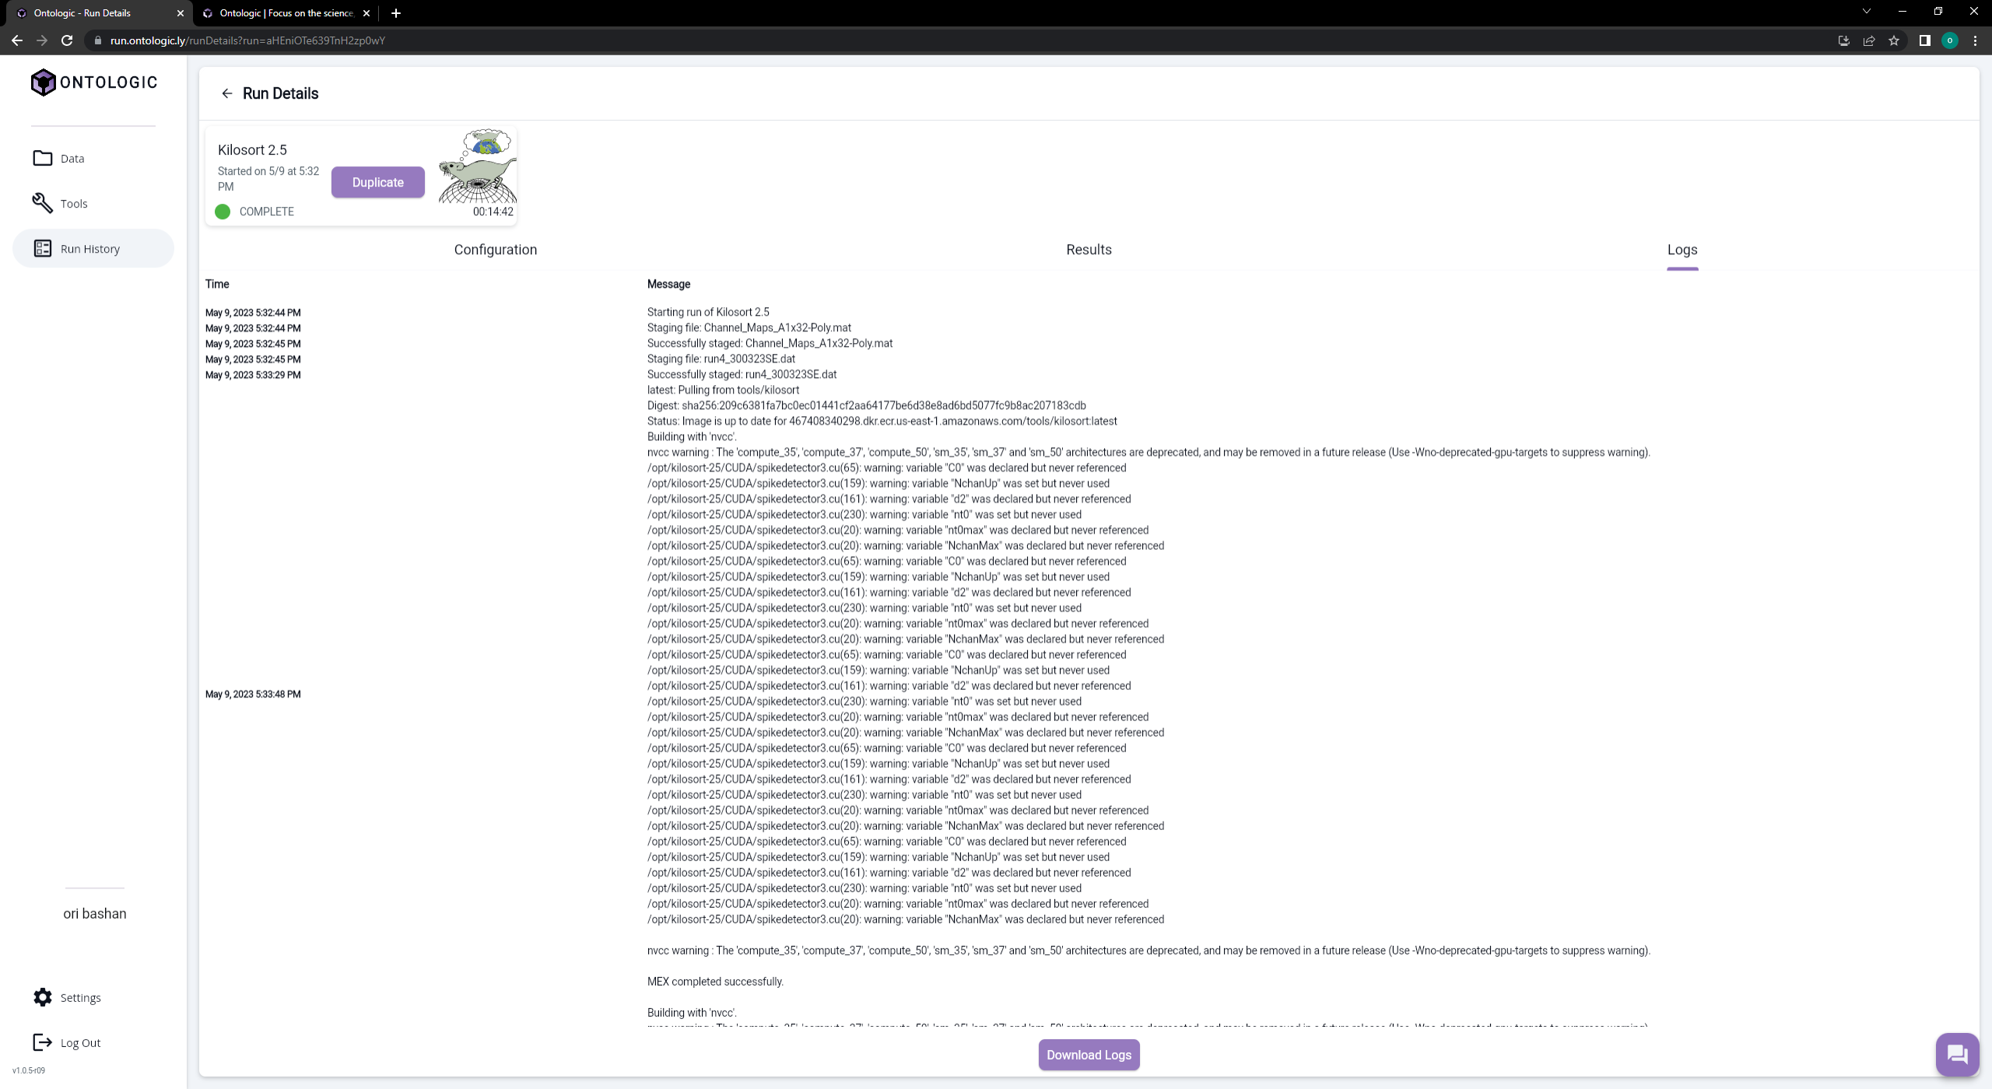

Slide 12
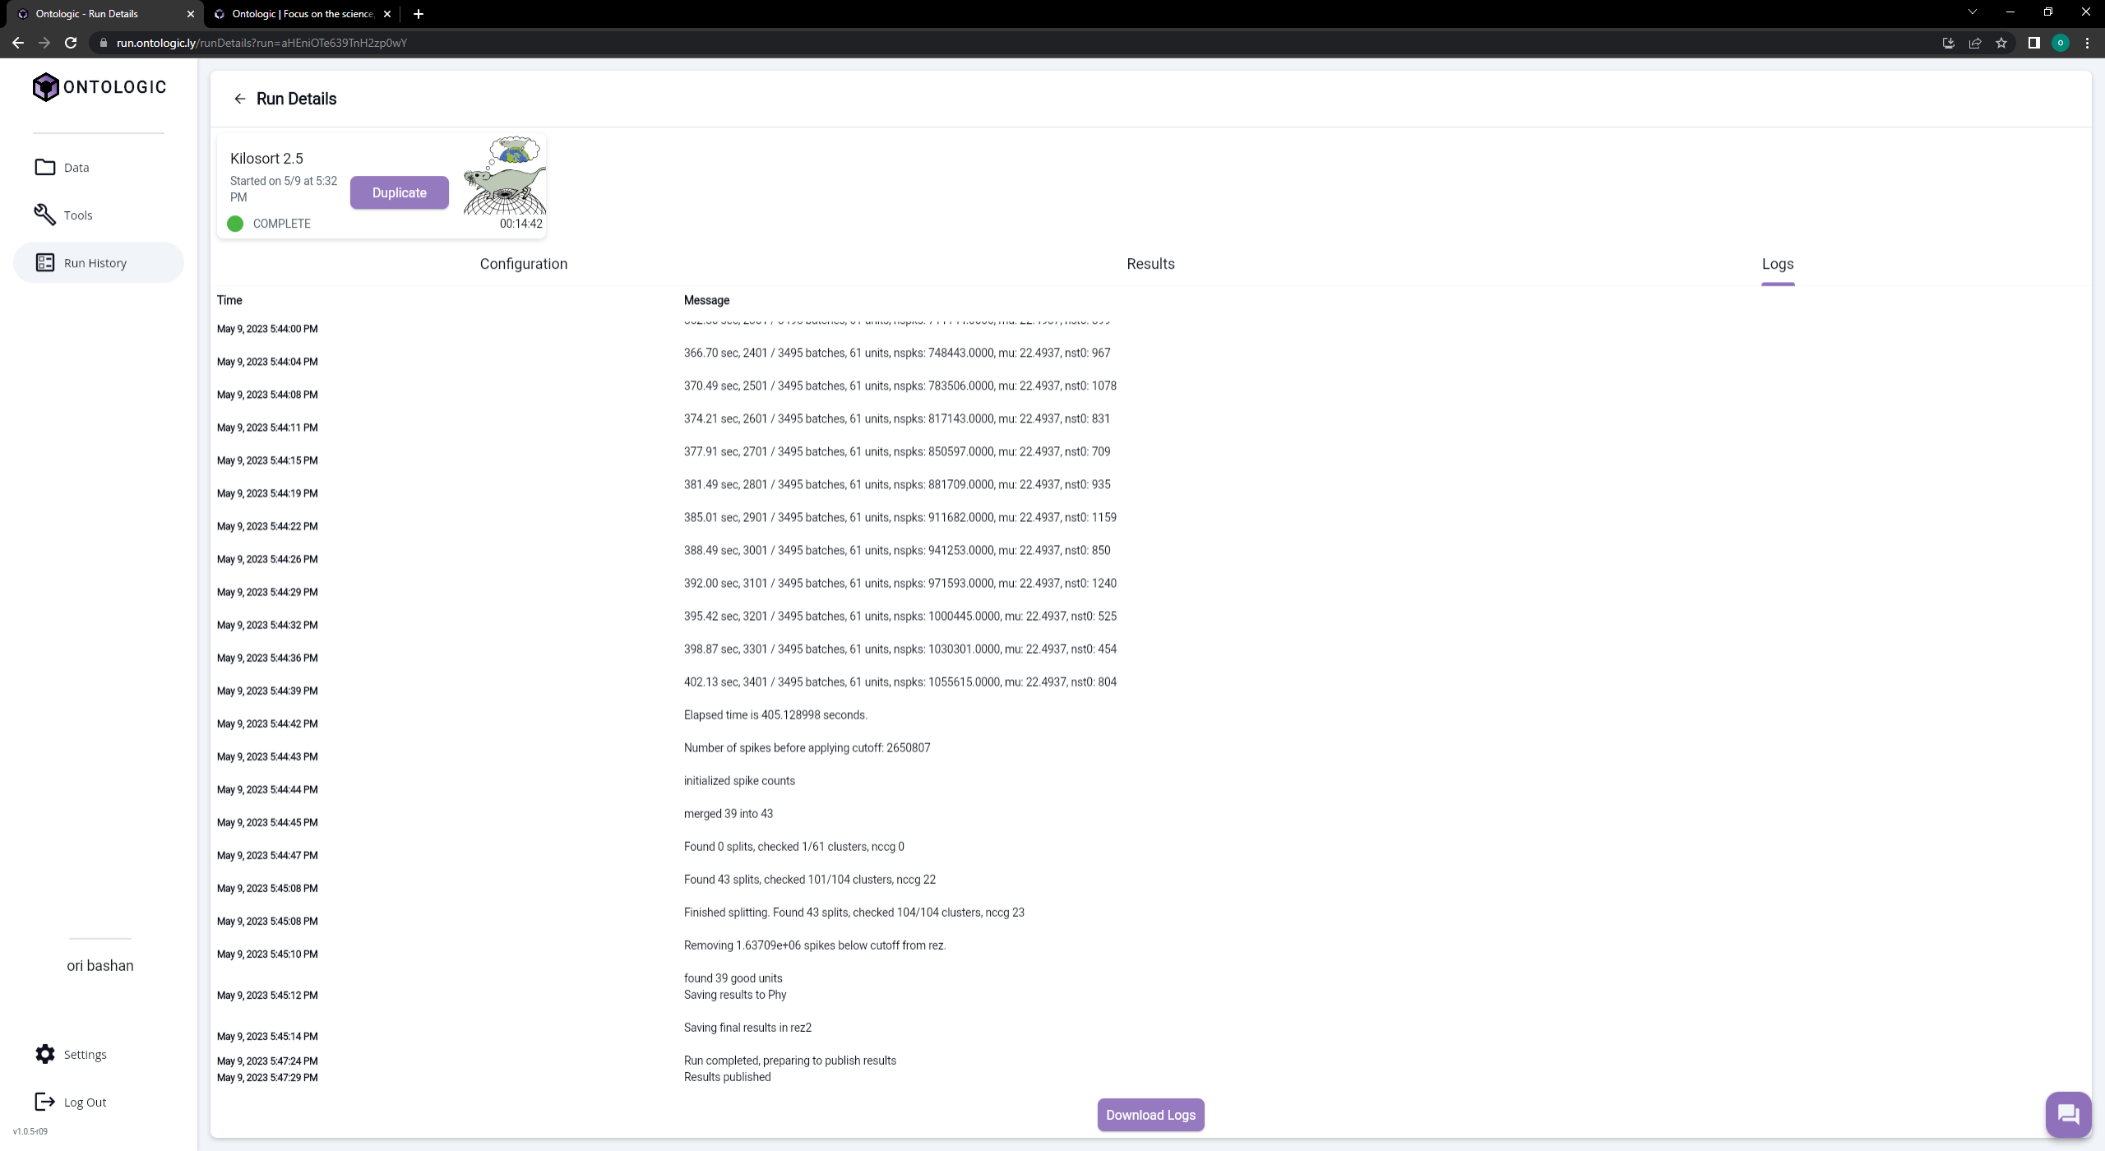

Slide 13
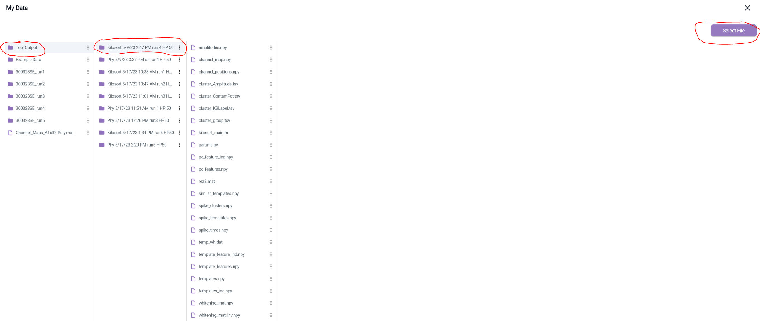
7. Run Phy on the kilosort results, go threw the results and merge/split/reassign the relevant clusters.

Slide 14
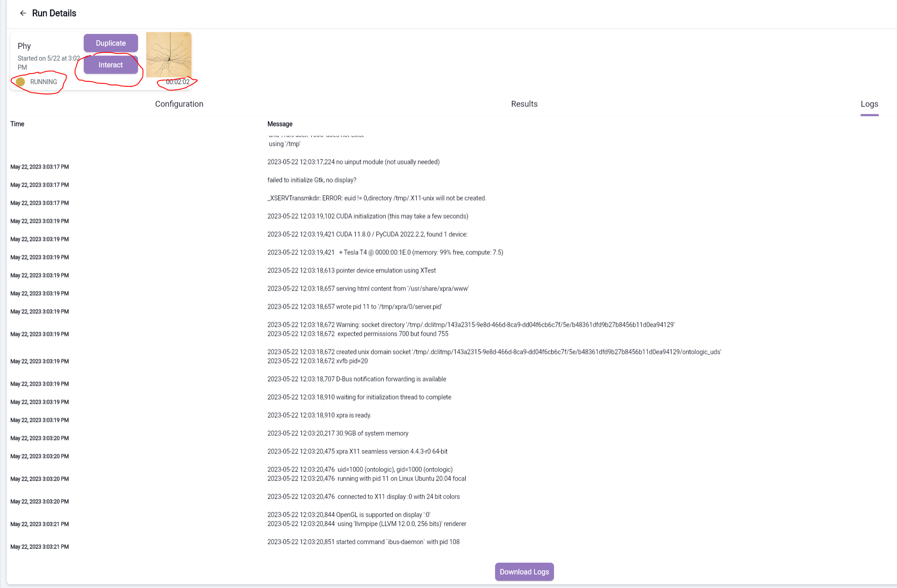

Slide 15
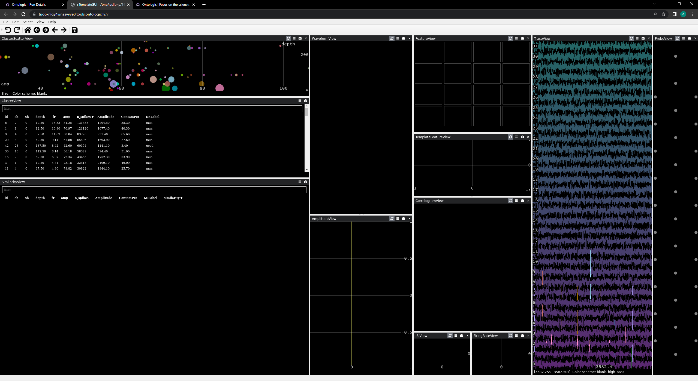

Slide 16
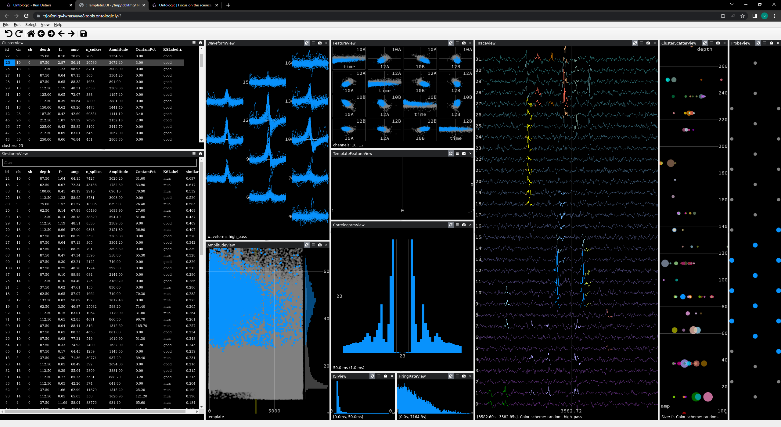

Slide 17
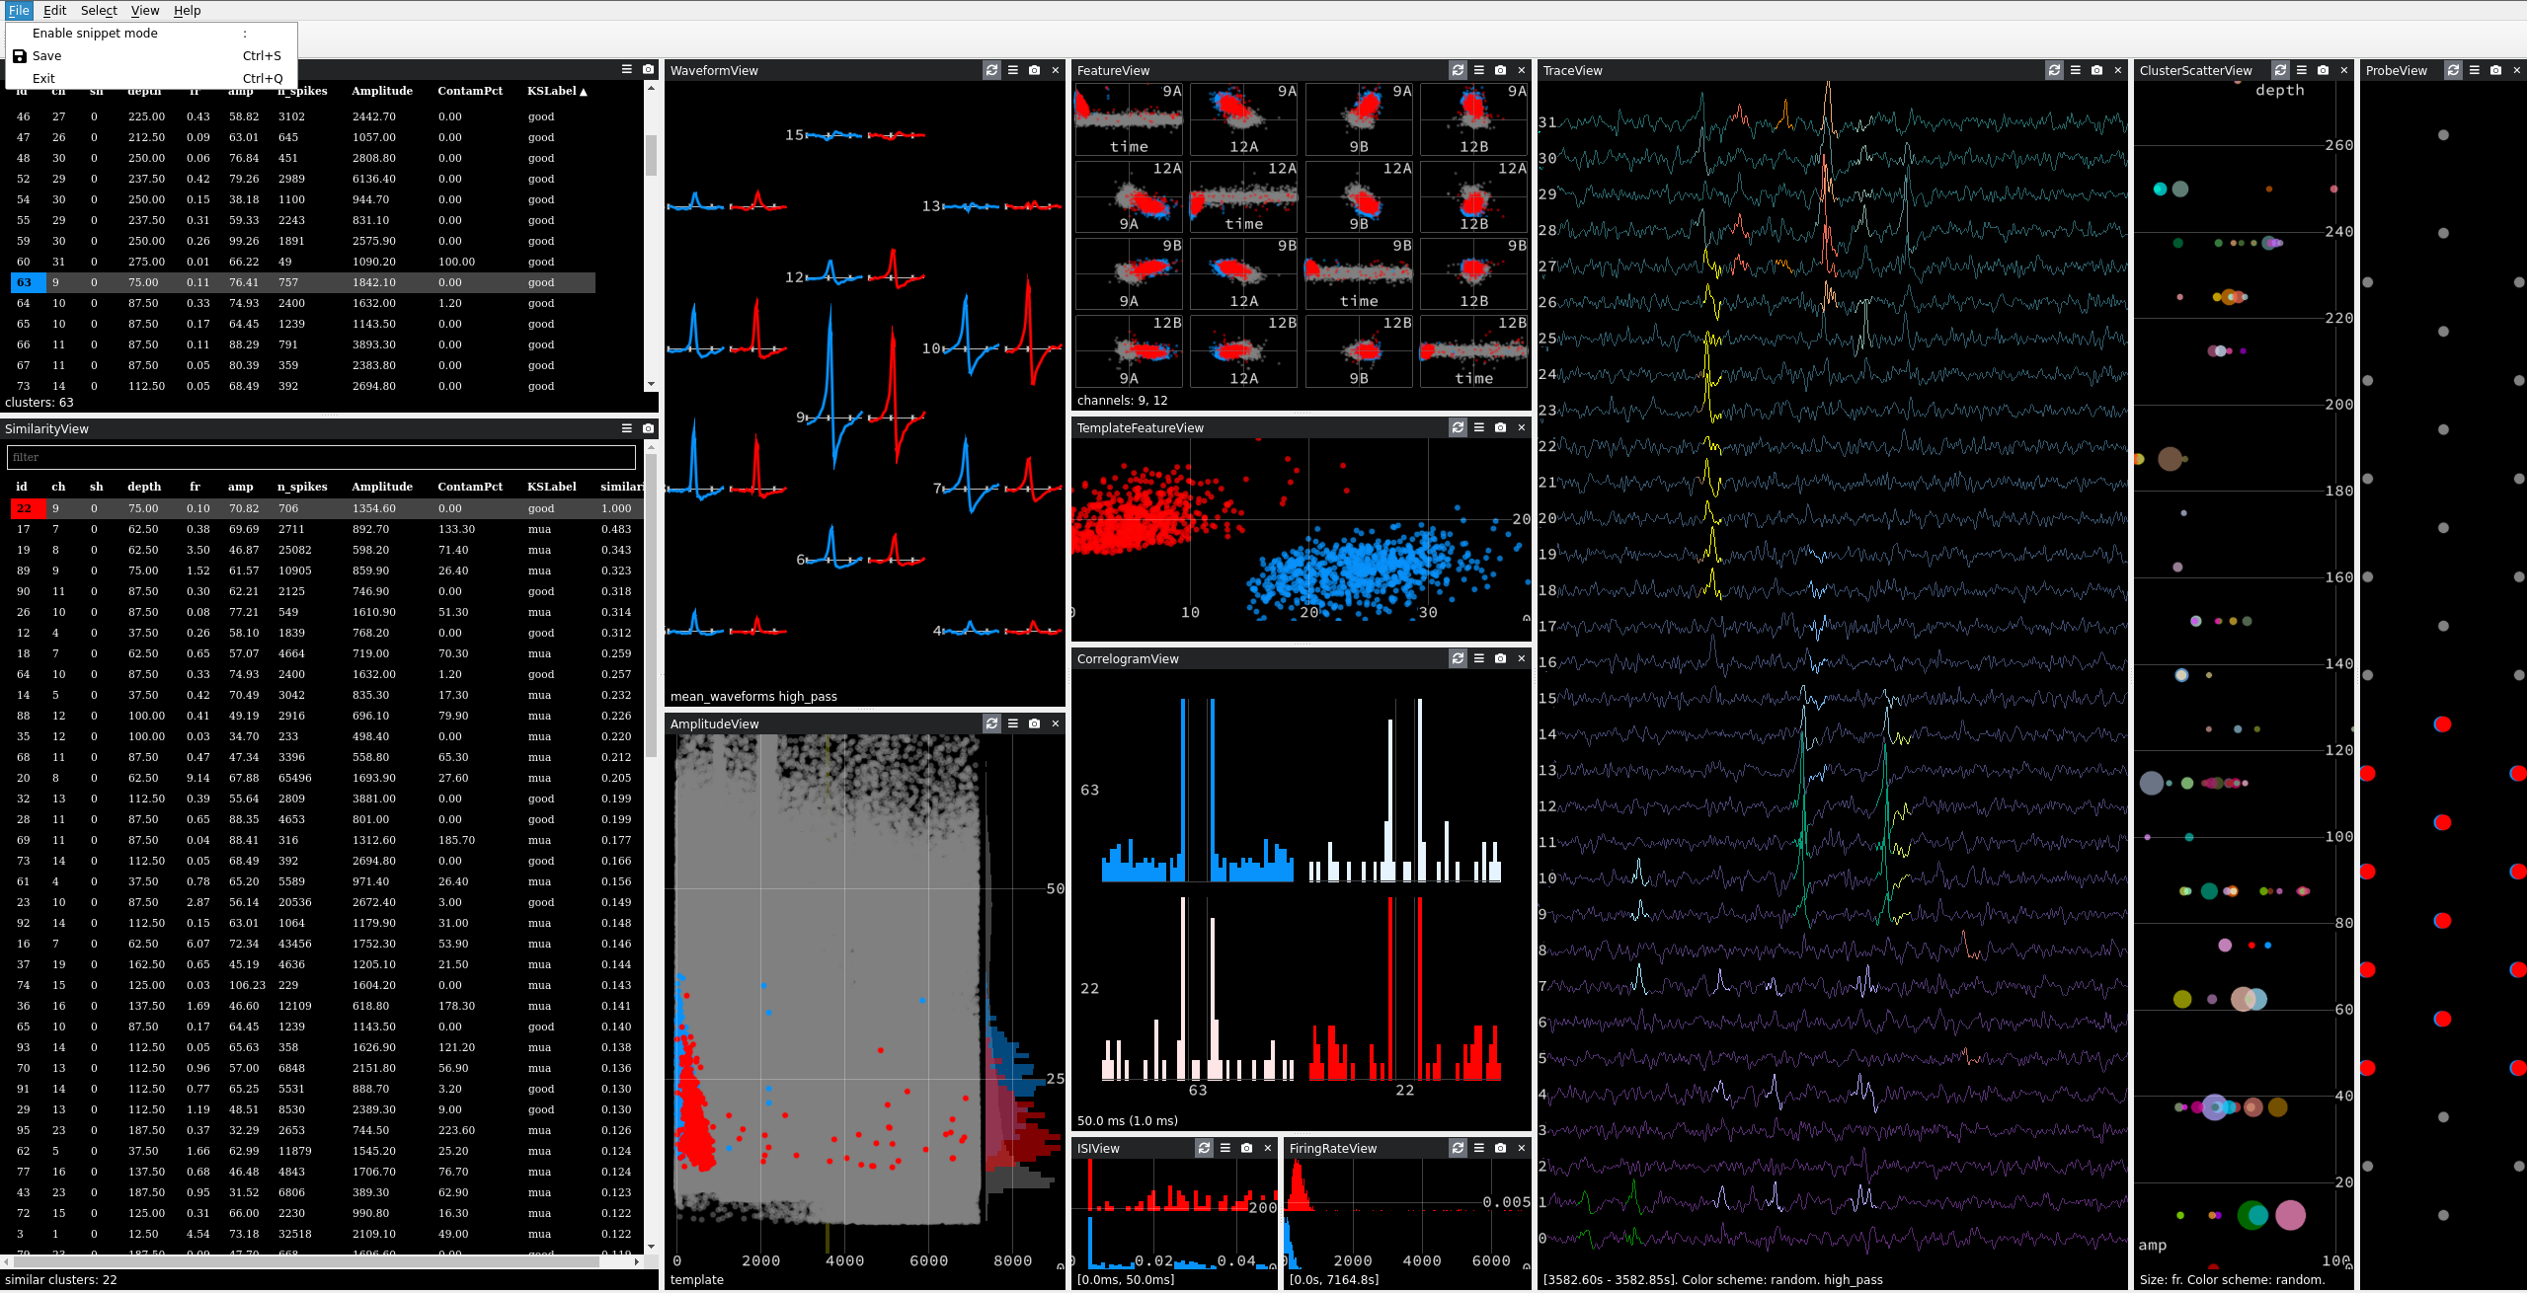

Slide 18
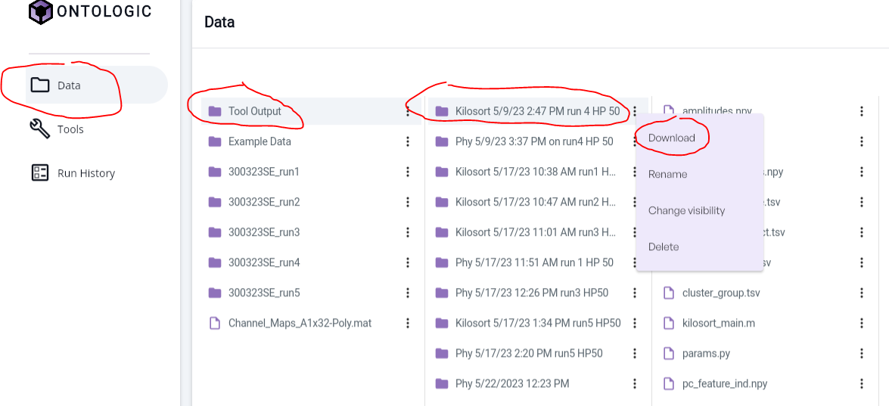
8. Download kilosort and phy results.

Slide 19
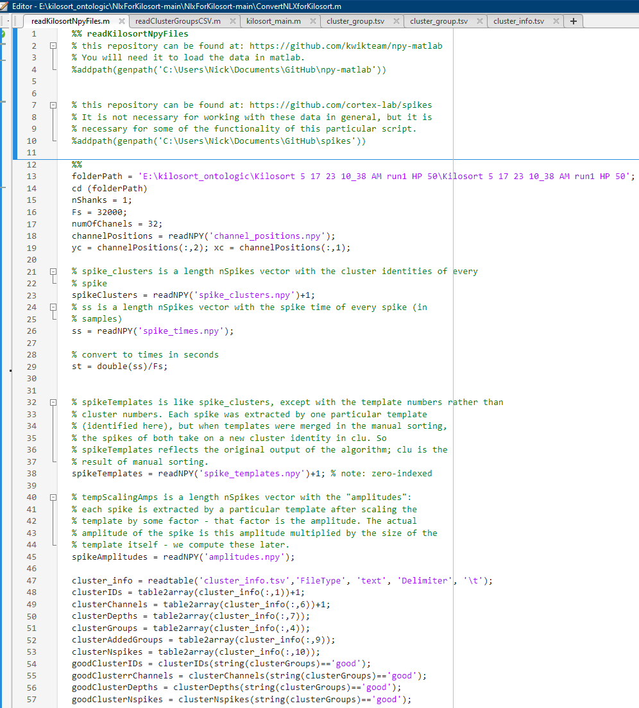
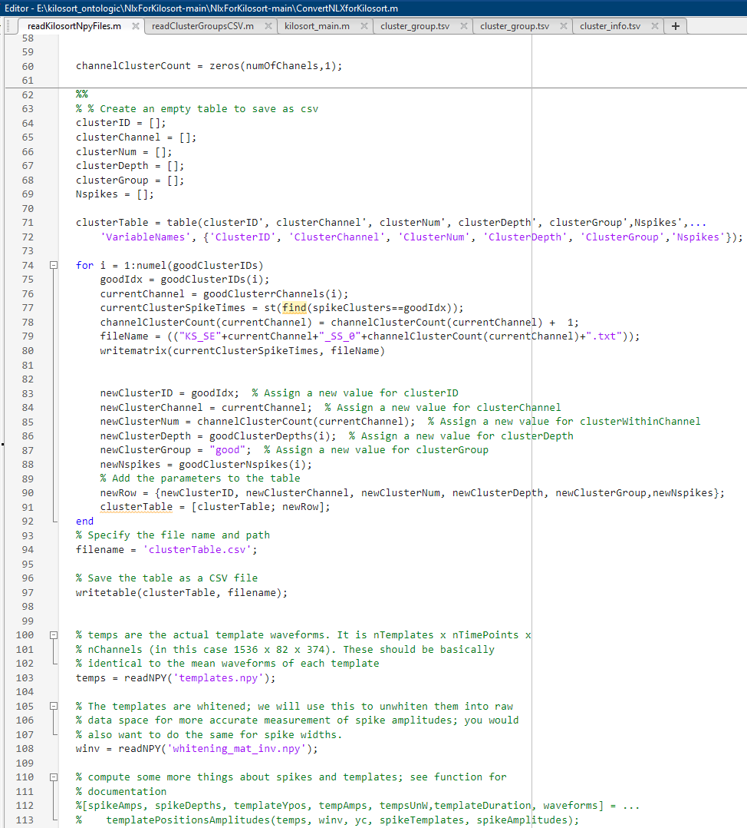
9. Read .npy files on matlab (using GitHub\npy-matlab library).

Slide 20


